Slide 1

Researching on Random Forest
By Henry Do and Michelle Reyes

Slide 2
Random Forest
A random forest is a machine learning technique that uses assemble of decision trees to make predictions.
Built on a random sample of data and building ongoing decision trees.
The more decision trees you have with criteria in each one, the better random tree is that’s used to solve regression and classification problems.
Example of regression problem: regression problem can be to predict the price of a house based on its size, location, number of rooms, etc
Example of classification problem: We could then use this model to predict whether or not a given player will get drafted into the NBA based on their average points per game and division level. This is an example of a classification model because the response variable (“drafted”) is categorical. That is, it can only take on values in two different categories: “Drafted” or “Not drafted.”
The (random forest) algorithm establishes the outcome based on the predictions of multiple decision trees. It predicts by taking the average or mean or majority vote of the output from various trees.
A decision tree consists of three components: decision nodes, leaf nodes, and a root node. The end meets a leaf node is found.

Slide 3
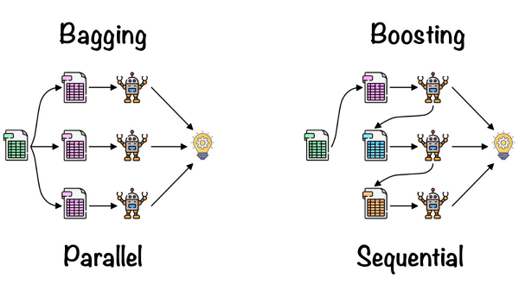
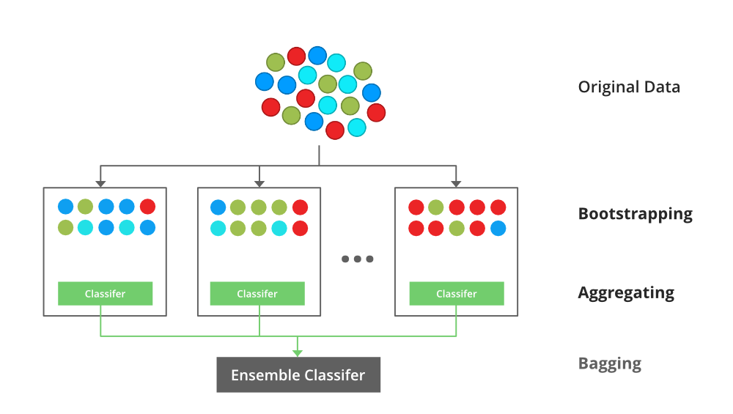
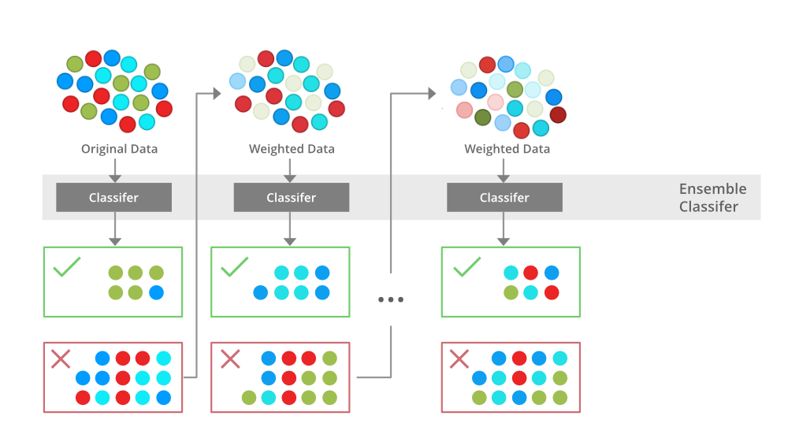
Two methods for the ensemble
Bagging (Bootstrap Aggregating)
Selection of Subset
Bootstrap Sampling
Bootstrapping
Independent Model Training
Majority Voting
Aggregation
Boosting (AdaBoost)
Initialization
Sequential Training
Weighted Voting
Update Weights
Repeat Iterations
Final Prediction

Slide 4
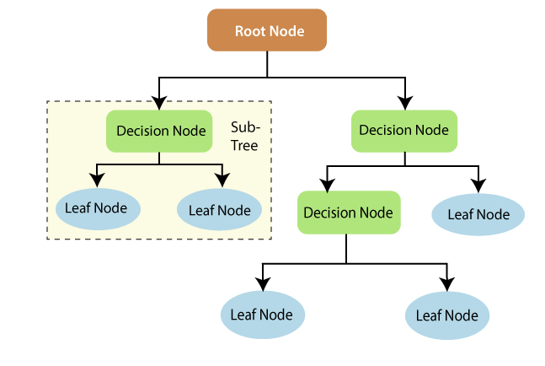
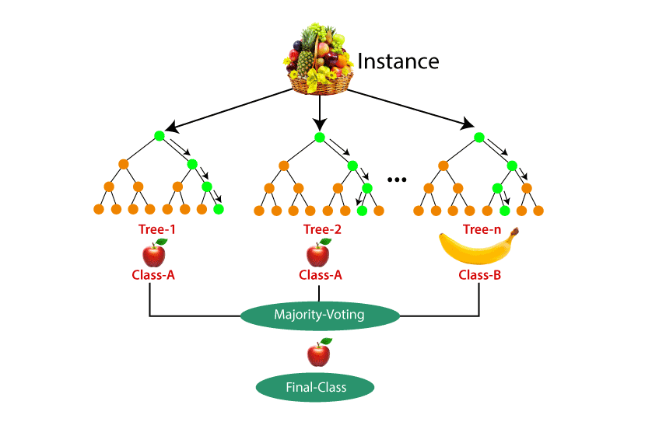
Decision tree vs Random Forest

Slide 5
Decision tree vs Random Forest (cont.)
Decision Tree | Random Forest
Decision trees normally suffer from the problem of overfitting if it’s allowed to grow without any control. | Random forests are created from subsets of data, and the final output is based on average or majority ranking; hence the problem of overfitting is taken care of.
A single decision tree is faster in computation. | It is comparatively slower.
When a data set with features is taken as input by a decision tree, it will formulate some rules to make predictions. | Random forest randomly selects observations, builds a decision tree, and takes the average result. It doesn’t use any set of formulas.
Fewer hyperparameters to tune, mainly related to tree depth and splitting criteria | Involves hyperparameters for both individual trees (like tree depth) and ensemble-specific hyperparameters (like the number of trees and feature subset size)
Quick to train as it constructs a single tree | Slower to train because it involves creating and training multiple Decision Trees. However, this can be parallelized for faster training on modern hardware

Slide 6
Pro’s
It handle large data sets such as the 12 columns we have in our program data
It can handle both classification and regression problems
regression minimize prediction errors and predicts an outcome based on the data such as the main goal of the program: predict behavior of the car driver → handles continuous quality
Classification is perfect for categorizing data, and predicting two possible outcomes
It can handle noisy data and outliers. * In the case of outliers in our data.
Higher accuracy and produces faster!
It has “feature importance”, which is a technique that shows which feature contributes most to the data → Can help predict the behavior of the car driver if we know what is the highest contributor.

Slide 7
Con's
The random forest prediction process takes a long time compared to other algorithms.
It is less intuitive when we have a large number of decision trees.
If the dataset contains data points that are significantly outside the range of the training data, the Random Forest may not make accurate predictions for such data points Like the first time it train it , it will difficult to handle new data.
Random Forest, being an ensemble of decision trees, doesn't naturally capture the temporal aspect of driver behavior It may not effectively consider the sequence of actions leading up to a lane change, such as a driver signaling, checking mirrors, and steering.
Random Forest is considered a "black box" model, which can make it challenging to explain why a particular decision was made and it is a also challenge for interpretability Autopilot systems require a high degree of interpretability and transparency, both for safety and regulatory compliance.

